Slide 1
Project_Study_2
The Use of Mathematics
in computer Games
1. Artiticle review
Department of Mathematics
Gyeongsang National University
Youngmin Shin
Notes:
이번에는 The use of mathematics in computer Games 라는 컴퓨터 게임에 사용되는 수학이라는 기사를 리뷰해봤습니다.

Slide 2
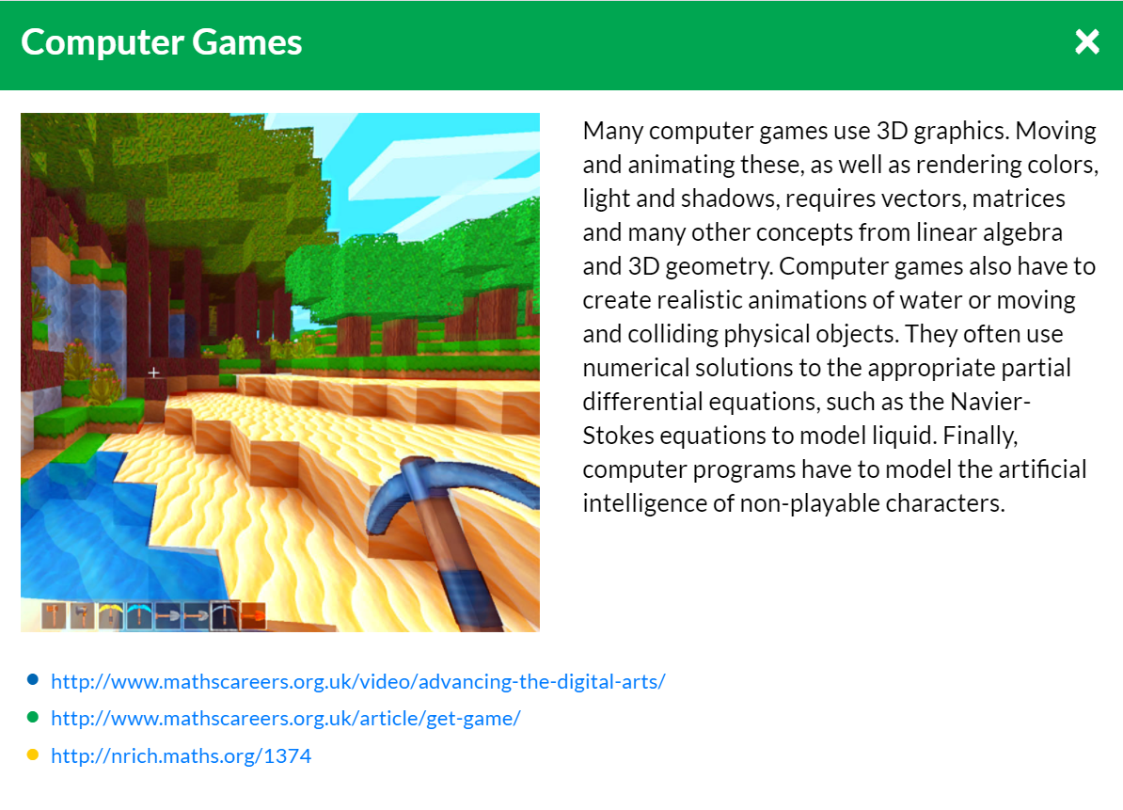
1. Subject
p1
A
B
C
<Figure 1>
Notes:
컴퓨터 게임에 세상을 3d로 나타내는 방법들이 흥미로울 것 같아 이 주제를 설정해 공부해보았습니다.

Slide 3
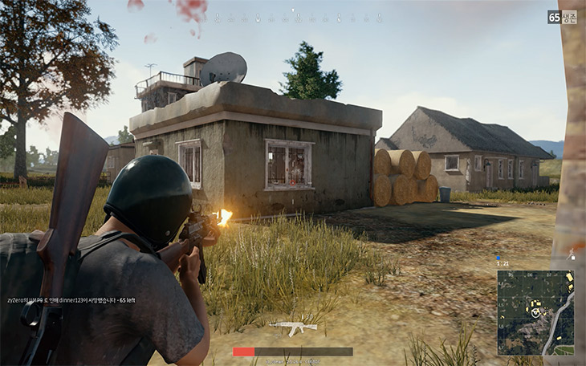
1. Introduction
p2
The purpose of this article is to have a look at how mathematics is used in computer games.
A
C
The First Person shooter(FPS)
<Figure 2>
Notes:
이 기사의 주제는 컴퓨터 게임에 수학이 어떻게 사용되는 가 입니다. 컴퓨터 게임의 종류는 정말 다양한데 먼저 The First person shooter라는 종류의 게임은 : 캐릭터의 시점에서 큰 총을 들고 3차원에서 진행되는 게임입니다. (배틀 그라운드 같은) 악 출처??
여러분이 잘 아시는 베그가 이에 해당합니다.

Slide 4
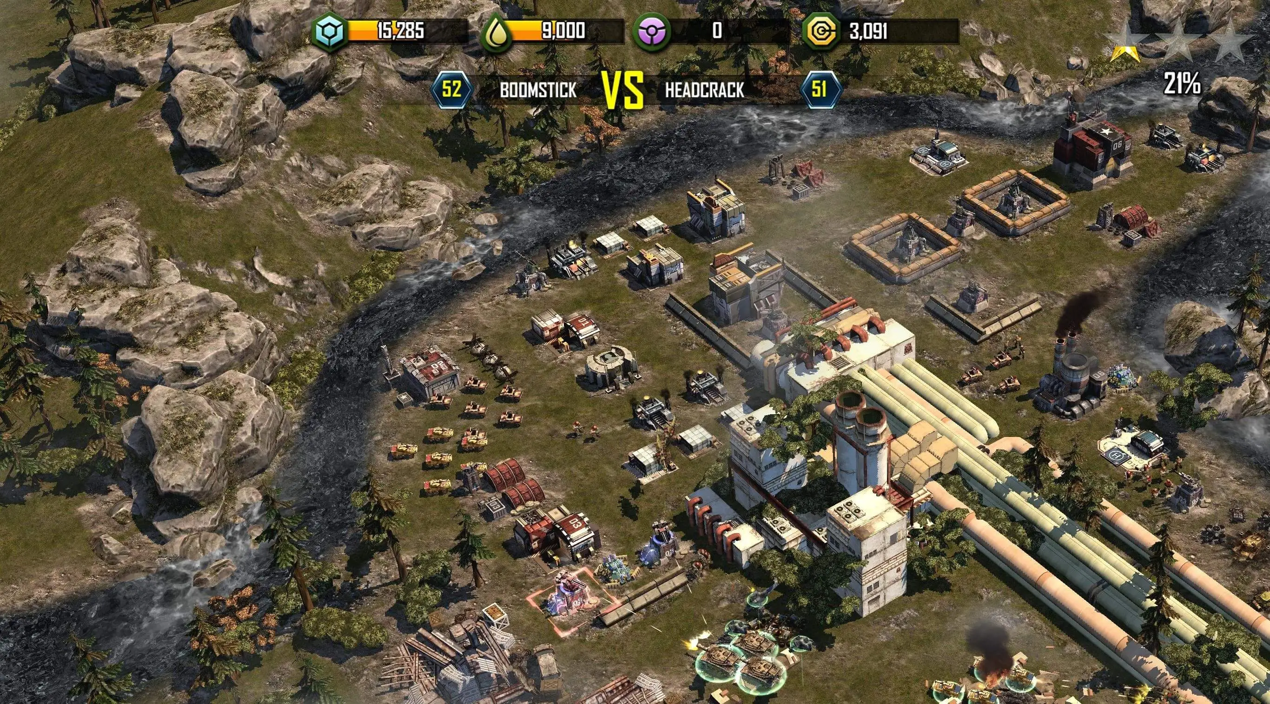
1. Introduction
p3
The purpose of this article is to have a look at how mathematics is used in computer games.
A
C
Strategy Games
-Real Time Strategy(RTS)
-Turn Time Strategy
<Figure 2>
Notes:
https://www.ipostjournal.com/the-best-military-strategy-games-for-android-and-ios-mobile/
두 번째로는 strategy game입니다. 이는 도시와 문명을 건설하고 전쟁을 하는 게임입니다.

Slide 5

1. Introduction
p4
The purpose of this article is to have a look at how mathematics is used in computer games.
A
C
Simulation Games
<Figure 2>
Notes:
https://terms.naver.com/entry.nhn?docId=3573182&cid=59088&categoryId=59096
마지막으로는 현실을 체험할 수 있는 simulation 게임입니다. 심즈 같은게임들이 이에 해당합니다.

Slide 6
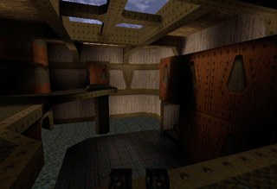
2. First Person Shooter
p5
advanced mathematics
Incredible Graphic
Notes:
https://nrich.maths.org/1374
먼저 퍼스트 person shooter 를 보겠습니다. 이러한 종류의 게임들 중에서 가장 놀라운 점은 엄청난 그래픽입니다. 거의 현실과 유사하게 표현합니다. 이는 수학이 없으면 할 수 없는 일입니다.

Slide 7
2.1 Geometry, vectors and Transformation
p6
Geometry: The study of shapes of various sort.
Point : The simplest shape.
Straight line : The simplest shape joining two points together.
Plane : The complicated shape.
Solid : The complicated shape.
Notes:
https://nrich.maths.org/1374
이 기사에서 는 일단 기하학을 공부하라고 해서 일단 보긴 했는데 기하학은 이미 아는 내용들이긴 했습니다. 일단 점은 가장 간단한 도형이고
직선은 두 점을 사용한 가장 간단한 도형 그리고 평면과 입체도형들은 복잡한 도형들이라고 합니다.

Slide 8
2.1 Geometry, vectors and Transformation
p7
A plane and a straight line create an intersection
Notes:
A plane and a straight line create an intersection.
평면과 직선이 만나면 점이 생깁니다. 우리는 이를 활용해서 그래픽을 어떻게 구성하는 지에 대해 이야기합니다.

Slide 9

2.1 Geometry, vectors and Transformation
p8
Vector ; $(x, y, z)$
Point
Direction
Notes:
A plane and a straight line create an intersection.
벡터도 나와있는데 이는 위치를 알려줄 수도 있고 방향을 알려주기도 합니다.

Slide 10
2.1 Geometry, vectors and Transformation
p9
Transformation
Rotation
Notes:
A plane and a straight line create an intersection.

Slide 11
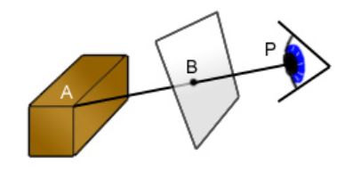
2.2 3D Graphics
p10
A simple idea for three-dimensional graphics is to explain the world mathematically and be shown to people.
Notes:
A plane and a straight line create an intersection.

Slide 12
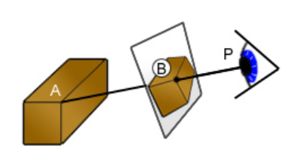
2.2 3D Graphics
p11
A simple idea for three-dimensional graphics is to explain the world mathematically and be shown to people.
Notes:
A plane and a straight line create an intersection.

Slide 13
2.2 3D Graphics
p12
Computers are similar to the previous method, but slightly different.
Notes:
A plane and a straight line create an intersection.

Slide 14
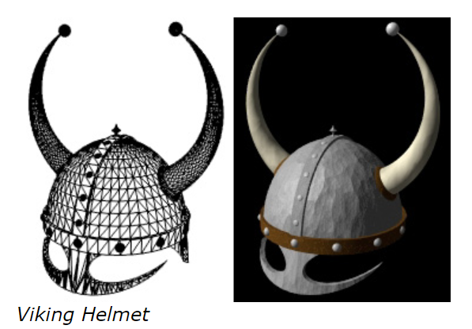
2.2 3D Graphics
p13
Computers are similar to the previous method, but slightly different.
Notes:
A plane and a straight line create an intersection.

Slide 15
2.2 3D Graphics
p14
Exercise 3. [Making triangles] Draw a picture of a box with a smaller box stuck to the top of it, using only triangles..
Notes:
A plane and a straight line create an intersection.

Slide 16
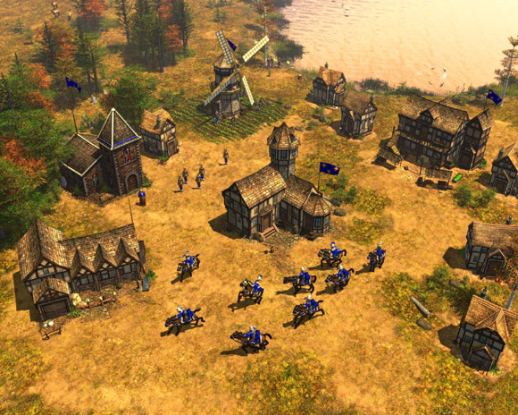
3. Strategy Games
p15
Strategy Games has simpler graphics than First person shooter.
Notes:
http://icdia.egloos.com/v/1723397

Slide 17


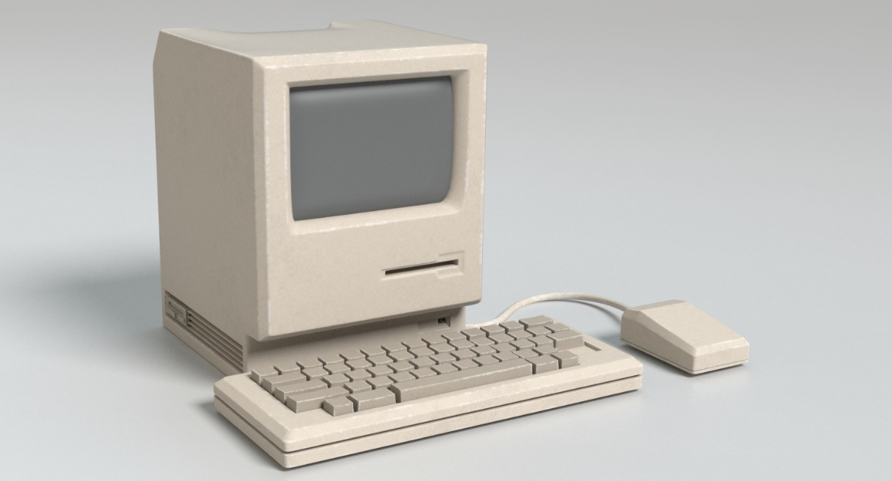
p16
3. Strategy Games
click
Notes:
https://full-change5920.tistory.com/m/166
https://www.turbosquid.com/ko/3d-models/old-computer-3d-model-1174372
https://www.britannica.com/story/do-we-really-use-only-10-percent-of-our-brain

Slide 18

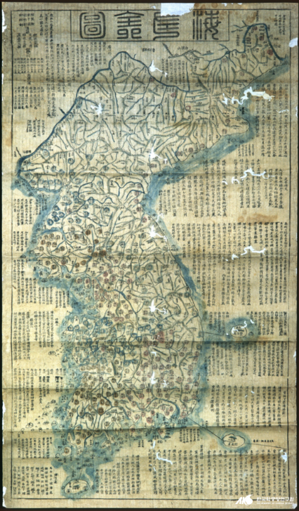

p17
3.1 Nodes, Edge and Graphics
Node
Edge
Graphic
Notes:
https://blog.naver.com/relache/220688886217
https://blog.naver.com/yahojeju/222199622974
https://terms.naver.com/entry.nhn?docId=795553&cid=46618&categoryId=46618

Slide 19
p18
3.1 Nodes, Edge and Graphics
A
C
A → C (O)
C → A (X)
Directed Edge
B
Notes:
https://blog.naver.com/relache/220688886217
https://blog.naver.com/yahojeju/222199622974
https://terms.naver.com/entry.nhn?docId=795553&cid=46618&categoryId=46618

Slide 20
p19
3.1 Nodes, Edge and Graphics
cost
B
C
5
30
A
Notes:
https://blog.naver.com/relache/220688886217
https://blog.naver.com/yahojeju/222199622974
https://terms.naver.com/entry.nhn?docId=795553&cid=46618&categoryId=46618

Slide 21
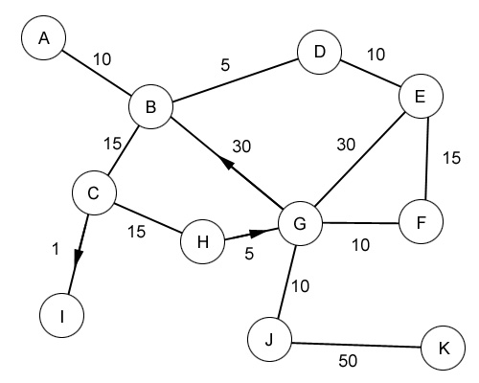
p20
3.1 Nodes, Edge and Graphics
Exercise 4 [Shortest Path] Work out the lowest cost way to get from A to K .
A→ B →C →H →J →K
Notes:
A plane and a straight line create an intersection.

Slide 22

p21
3.1 Path Finding
Interesting Points
Nodes
Notes:
https://m.blog.naver.com/PostView.nhn?blogId=changok321&logNo=220859372142&proxyReferer=https:%2F%2Fwww.google.com%2F

Slide 23
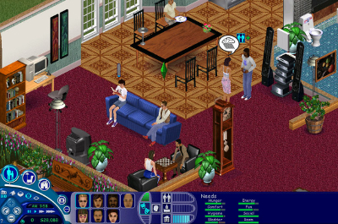
p22
4. Simulation Games
The most important thing in Simulation Games is to make it like the real world. Physical simulation is used for this purpose.
Notes:
https://www.maximumgames.com/press/playing-with-reality-what-makes-simulation-game/

Slide 24
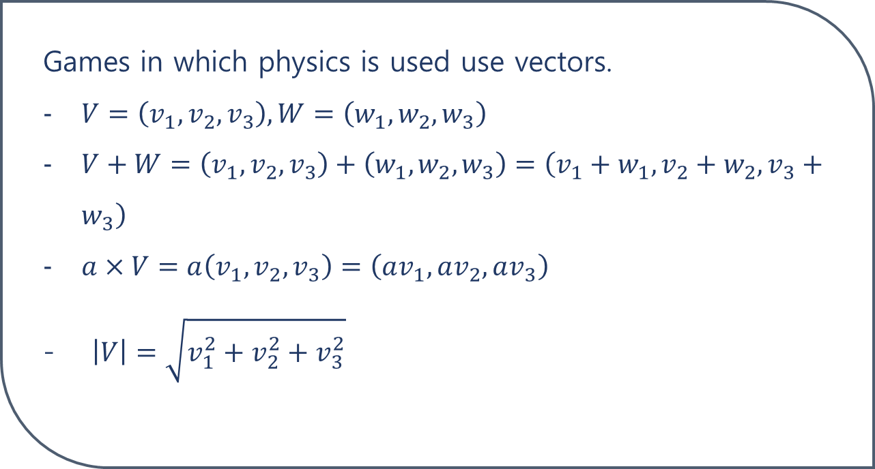
p23
4.1 More on vector
Games in which physics is used use vectors.
$V=\left(v_{1}, v_{2}, v_{3}\right), W=\left(w_{1}, w_{2}, w_{3}\right)$
$V+W=\left(v_{1}, v_{2}, v_{3}\right)+\left(w_{1}, w_{2}, w_{3}\right)=\left(v_{1}+w_{1}, v_{2}+w_{2}, v_{3}+w_{3}\right)$
$a×V=a\left(v_{1}, v_{2}, v_{3}\right)=\left(av_{1}, av_{2}, av_{3}\right)$
$\left|V\right|=\sqrt{v_{1}^{2}+v_{2}^{2}+v_{3}^{2}}$
Notes:
https://www.maximumgames.com/press/playing-with-reality-what-makes-simulation-game/

Slide 25
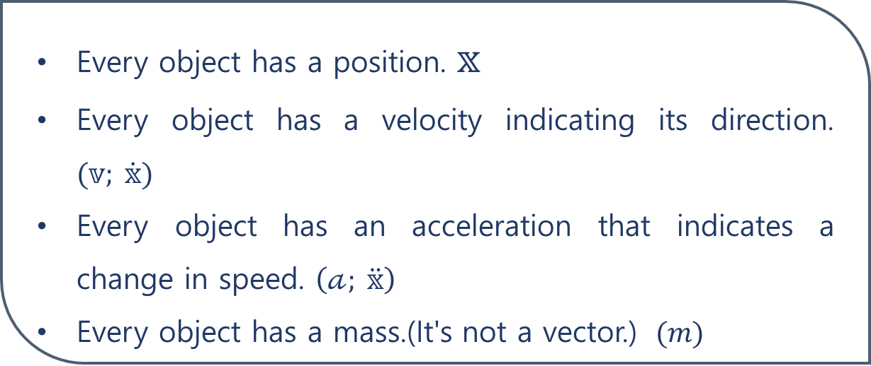
p24
4.2 Physics
Every object has a position. $𝕩$
Every object has a velocity indicating its direction. $(𝕧; \dot{𝕩})$
Every object has an acceleration that indicates a change in speed. $\left(𝒶; \ddot{𝕩}\right)$
Every object has a mass.(It's not a vector.) $(m)$
Notes:
https://www.maximumgames.com/press/playing-with-reality-what-makes-simulation-game/

Slide 26
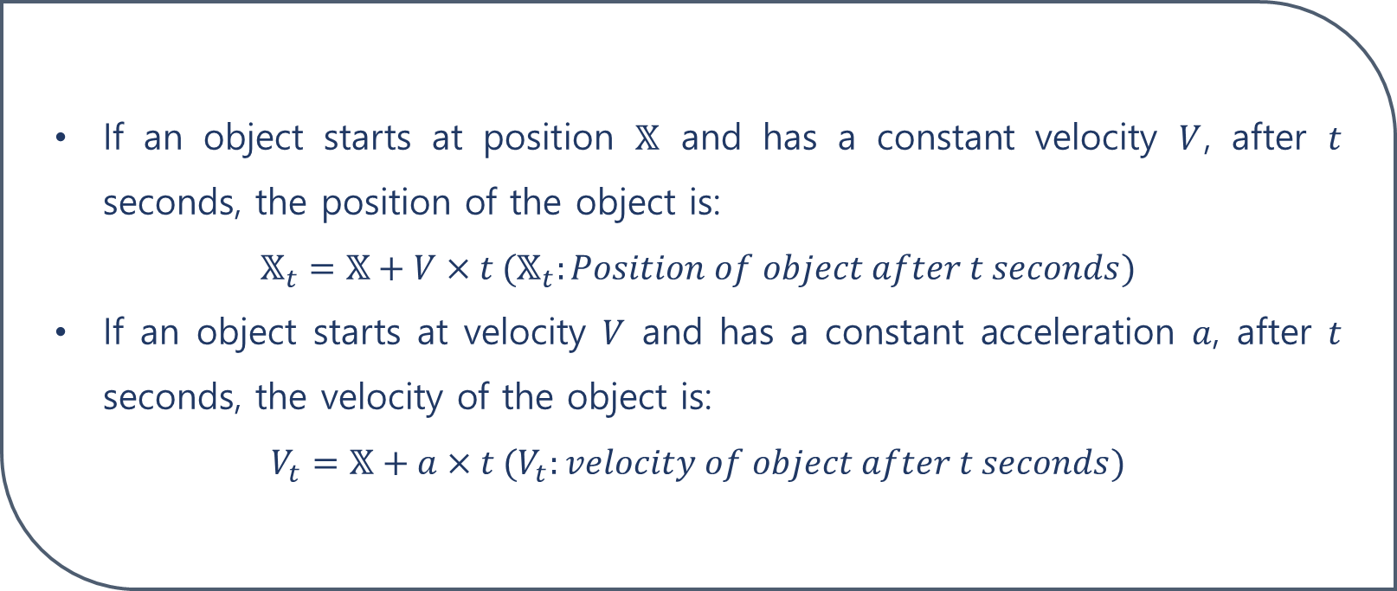
p25
4.2 Physics
If an object starts at position $𝕏$ and has a constant velocity $V$, after $t$ seconds, the position of the object is:
$$𝕏_{t}=𝕏+V×t (𝕏_{t}:Position of object after t seconds)$$
If an object starts at velocity $V$ and has a constant acceleration $a$, after $t$ seconds, the velocity of the object is:
$$V_{t}=𝕏+a×t (V_{t}:velocity of object after t seconds)$$
Notes:
https://www.maximumgames.com/press/playing-with-reality-what-makes-simulation-game/

Slide 27
p26
4.3 Simulation Games
It's hard to apply physics realistically in real games. This is because we have to consider wind or friction caused by the air in the real world.
There is no game with accurate physics. It is under constant study.
Notes:
https://www.maximumgames.com/press/playing-with-reality-what-makes-simulation-game/

Slide 28
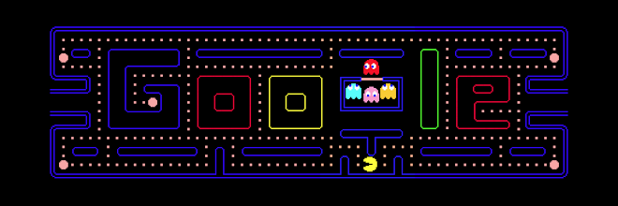
p27
5. Conclusion
So far, I have shown simple examples of where math is used when making computers.
In fact, it is almost impossible to play a game without using math.
Even Pacman uses some math!!
Notes:
https://www.google.com/doodles/30th-anniversary-of-pac-man?hl=ko

Slide 29
Thank you!

